Slide 1
STOCK ANALYSIS
USING ARTIFICIAL INTELLIGENCE

Slide 2
GROUP MEMBERS
AMAN KUMAR (1721610015)
KUSHAL SHARMA (1721610057)
ASHISH VERMA (1721610023)
ABHISHEK SHARMA (1721610008)
BHAVYA GARG (1721610030)
AKASH

Slide 3
What is stock analysis?
Stock analysis is the method used by a trader or investor to examine and evaluate the stock market. It is then used to make informed decisions about buying and selling shares. Stock analysis can also be referred to as market analysis, or equity analysis.
Stock analysis can be used to gain an insight in to the economy as a whole, the stock market, a specific sector or an individual stock.
Stock analysis is based on the idea that by studying market data from the past and present, traders can create a methodology for choosing which stocks to focus on, as well as a way to identify entry and exit points for their trades.

Slide 4
How to analyze stock?
There are seven ways to analyze stock
P/E RATIO
EARNINGS PER SHARE
PEG RATIO
BOOK VALUE
RETURN ON EQUITY
ANALYST RECOMMENDATION
Technical Analysis

Slide 5

We introduce the 8th way
ARTIFICIAL INTELLIGENCE

Slide 6
HOW Artificial intelligence will help?
Technical research relates to the study of past stock prices to predict the trend of prices in future. It shows you the direction of movement of the share prices. With the help of technical research, you can identify whether there will be sharp rise or fall in the price of share. It is not dependent on recent news or events which has already been incorporated in the price of the share.
As the stock prices are dependent on investor psychology which keeps changing according to news and events, technical research emphasises the use of Stop-losses. It will save investors from suffering a big loss in future. Technical research gives meaningful results only for stocks which are high in demand and traded in huge volumes. Technical research uses different types of charts like bar chart, candlestick chart; to understand the pattern of stock prices. Daily charts are used by short term traders to examine the immediate movement in the stock prices. Weekly / monthly charts are used by medium/long term traders to ascertain the probability to earn higher more in the long run.

Slide 7
About dataset
Each row represent the daily stock Market data, each columns contains the attributes that described on the columns metadata. The raw data contains 2335 rows and 7 columns.
Date: date of the stock.
Open: price of the stock at market open
High: Highest price reached in the day
Low: Lowest price reached in the day
Close: price of the day at market close
Adj. Close: Adjusted closing price amends a stock’s closing price to accurately reflect that stock's value after accounting for any corporate actions.
Volume: Number of shares traded

Slide 8
It is not always necessary that the dataset we get is useful for the final result so, We used the raw data to create new columns/features that are more related or more useful to our project using feature engineering, the feature that we introduce are –
High-low: we can check the daily volatility of the stock by high-low change.
Daily% change: we can also check the daily volatility of the stock by daily% change.
Predic.Price: label is the final price of the stock which we want to predict.

Slide 9
hoW it works
Our whole project is based on the regression problem. Now for the Stock Price Prediction there are plenty of algorithms that can predict the Price of the stock but here for the scope of this project report only one machine learning model will be sufficient. Here, we are going to train Linear Regression Model on Stock Dataset and get their result and check their predictive ability for future Prices

Slide 10
Model used
Linear Regression
The basic concept of this algorithm mentioned are and given in chapter 2 of this project report and from this point, this project report will be oriented towards understanding of the working of the Linear Regression model. How this model work? We are going to train Linear Regression Model on the Dataset and check the predictive ability of the model. How good this model work, the steps related to this project are:
Data extraction
Missing value detection
Missing value handling
Feature engineering
Visualization
Appling and comparing the results of the model
Conclusion of the model analysis

Slide 11

Accuracy score

Slide 12
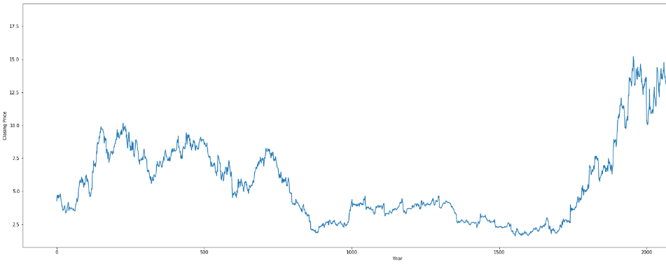
Visualisation of adj. close

Slide 13
results

Slide 14
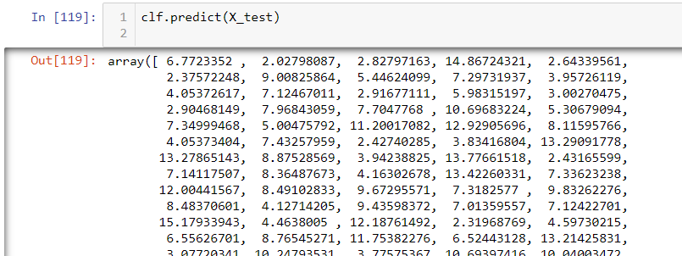
PREDICTIONS

Slide 15
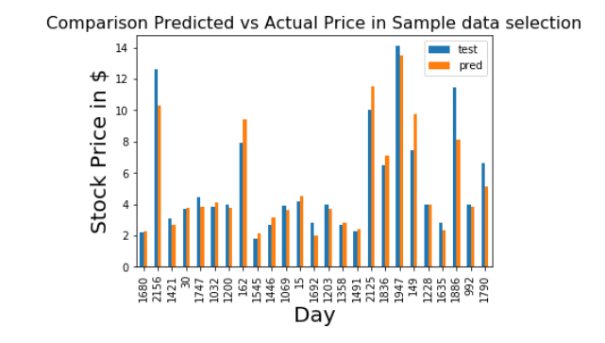
comparison

Slide 16
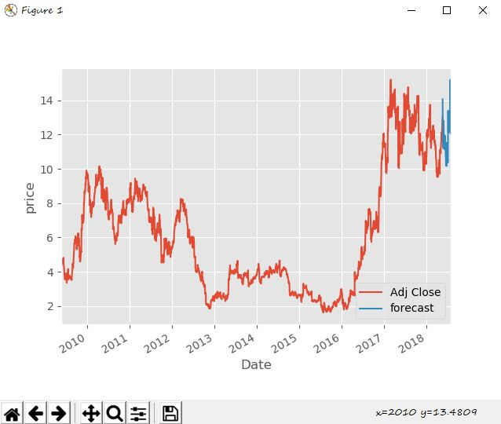
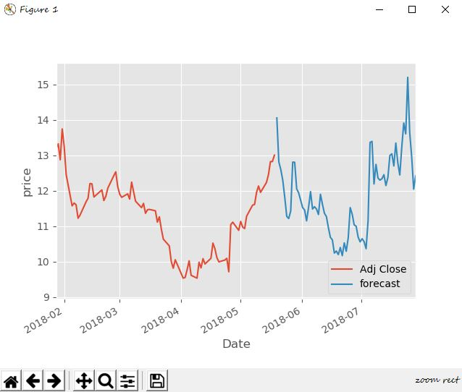
Graphical representation of predictions

Slide 17
thankyou

